Slide 1


What Drove Trend & Carry Returns?
© Return Stacked® ETFs
May 2026

Slide 2

Important Disclosures
Return Stacked® ETFs
2026
Investors should carefully consider the investment objectives, risks, charges and expenses of the Return Stacked® ETFs. This and other important information about the ETFs is contained in their prospectuses, which can be obtained by calling 1-844-737-3001 or www.returnstackedetfs.com. The prospectuses should be read carefully before investing.
Investments involve risk. Principal loss is possible. Unlike mutual funds, ETFs may trade at a premium or discount to their net asset value. Brokerage commissions may apply and would reduce returns.
Tidal Investments, LLC (“Tidal”) serves as investment adviser to the Funds and the Funds’ Subsidiary.
Newfound Research LLC (“Newfound”) serves as investment sub-adviser to the Funds.
ReSolve Asset Management SEZC (Cayman) (“ReSolve”) serves as futures trading advisor to the Return Stacked® U.S. Stocks and Managed Futures ETF, the Return Stacked® U.S. Stocks & Futures Yield ETF, and their respective Subsidiaries.
The Return Stacked® ETF suite is distributed by Foreside Fund Services, LLC, Member FINRA/SIPC. Foreside is not related to Tidal, Newfound or ReSolve.

Slide 3
Important Risks
Return Stacked® ETFs
2026
Investing involves risk, including loss of principal. The value of the fund's shares, when redeemed, may be worth more or less than their original cost. There is no guarantee that any investment strategy will achieve its objectives, generate profits or avoid losses.
ETFs are subject to specific risks, depending on the nature of the underlying strategy of the fund. These risks could include liquidity risk, sector risk, as well as risks associated with fixed income securities, real estate investments, and commodities, to name a few. While the shares of ETFs are tradeable on secondary markets, they may not readily trade in all market conditions and may trade at significant discounts in periods of market stress. ETFs trade like stocks, are subject to investment risk, fluctuate in market value and may trade at prices above or below the ETF's net asset value. Brokerage commissions and ETF expenses will reduce returns. There is no guarantee that the Fund will achieve its objective.
Derivatives Risk. Derivatives are instruments, such as futures contracts, whose value is derived from that of other assets, rates, or indices. The use of derivatives for non-hedging purposes may be considered to carry more risk than other types of investments.
Bond Risks. The Fund will be subject to bond and fixed income risks through its investments in U.S. Treasury securities, broad-based bond ETFs, and investments in U.S. Treasury and fixed income futures contracts. Changes in interest rates generally will cause the value of fixed-income and bond instruments held by Fund (or underlying ETFs) to vary inversely to such changes.
Credit Risk. Credit risk refers to the possibility that the issuer of a security will not be able to make principal and interest payments when due. Changes in an issuer’s credit rating or the market’s perception of an issuer’s creditworthiness may also affect the value of the Fund’s investment in that issuer.
Currency Risk. Currency risk is the risk that changes in currency exchange rates will negatively affect securities denominated in, and/or receiving revenues in, foreign currencies. The liquidity and trading value of foreign currencies could be affected by global economic factors, such as inflation, interest rate levels, and trade balances among countries, as well as the actions of sovereign governments and central banks.

Slide 4
Important Risks
Return Stacked® ETFs
2026
Foreign and Emerging Markets Risk. Foreign and emerging market investing involves currency, political and economic risk.
Leverage Risk. As part of the Fund’s principal investment strategy, the Fund will make investments in futures contracts to gain long and short exposure across four major asset classes (commodities, currencies, fixed income, and equities). These derivative instruments provide the economic effect of financial leverage by creating additional investment exposure to the underlying instrument, as well as the potential for greater loss.
Non-Diversification Risk. The Fund is non-diversified, meaning that it is permitted to invest a larger percentage of its assets in fewer issuers than diversified funds.
Cayman Subsidiary Risk. By investing in the Fund’s Cayman Subsidiary, the Fund is indirectly exposed to the risks associated with the Subsidiary’s investments. The futures contracts and other investments held by the Subsidiary are subject to the same economic risks that apply to similar investments if held directly by the Fund. The Subsidiary is not registered under the 1940 Act, and, unless otherwise noted in the Fund’s Prospectus, is not subject to all the investor protections of the 1940 Act.
Commodity Risk. Investing in physical commodities is speculative and can be extremely volatile.
Commodity-Linked Derivatives Tax Risk. The tax treatment of commodity-linked derivative instruments may be adversely affected by changes in legislation, regulations, or other legally binding authority. As a registered investment company (RIC), the Fund must derive at least 90% of its gross income each taxable year from certain qualifying sources of income under the Internal Revenue Code. If, as a result of any adverse future legislation, U.S. Treasury regulations, and/or guidance issued by the Internal Revenue Service, the income of the Fund from certain commodity-linked derivatives, including income from the Fund’s investments in the Subsidiary, were treated as non-qualifying income, the Fund may fail to qualify as RIC and/or be subject to federal income tax at the Fund level. The uncertainty surrounding the treatment of certain derivative instruments under the qualification tests for a RIC may limit the Fund’s use of such derivative instruments.

Slide 5
Important Risks
Return Stacked® ETFs
2026
Commodity Pool Regulatory Risk. The Fund’s investment exposure to futures instruments will cause it to be deemed to be a commodity pool, thereby subjecting the Fund to regulation under the Commodity Exchange Act and the Commodity Futures Trading Commission rules. Because the Fund is subject to additional laws, regulations, and enforcement policies, it may have increased compliance costs which may affect the operations and performance of the Fund.
Underlying ETFs Risk. The Fund will incur higher and duplicative expenses because it invests in equity ETFs. The Fund may also suffer losses due to the investment practices of the underlying bond ETFs.

Slide 6
5/31/2025 to 5/31/2026
A Standout Year for Return Stacking
S&P 500
Return Stacked® U.S. Stocks & Managed Futures ETF
RSST (NAV)
Return Stacked® U.S. Stocks &
Futures Yield ETF
RSSY (NAV)
Trend Stack
Carry Stack
+29.8%
+56.1%
+48.6%
TOTAL RETURN
TOTAL RETURN
TOTAL RETURN
The performance data quoted above represents past performance. Past performance does not guarantee future results. The investment return and principal value of an investment will fluctuate so that an investor’s shares, when sold or redeemed, may be worth more or less than their original cost and current performance may be lower or higher than the performance quoted above. Performance current to the most recent month-end can be obtained at www.returnstackedetfs.com. See slides 18 and 19 for standardized performance.
Source: Bloomberg; Calculations by Newfound Research. S&P 500 is SPXT Index. Returns for the S&P 500 are gross of all management fees, transaction costs and taxes. You cannot invest in an index. Returns for RSST and RSSY are based upon fund NAV. Returns for RSST and RSSY are net of management fees and internal transaction costs but gross of taxes. All returns assume the reinvestment of all distributions. Past returns are not indicative of future returns. The Gross Expense Ratio for RSST is 0.99%; the Gross Expense Ratio for RSSY is 0.99%.

Slide 7
THE MECHANICS
What is Return Stacking?
TRADITIONAL PORTFOLIO
RETURN STACKED® PORTFOLIO
$1.00 invested → $1.00 of exposure
$1.00 invested → $2.00 of exposure
100% STOCKS
100% STOCKS
+
To add a diversifier, you must give up some equity to make room.
100% DIVERSIFIER
Same capital. The diversifier rides on top.

Slide 8
THE PROBLEM WE SEEK TO SOLVE
Why Return Stacking Exists
01
The historical constraint
For most of investing history, capital was rationed. A 60/40 portfolio meant 60% stocks and 40% bonds. To add managed futures, you had to take from one or the other. That's the funding problem.
02
What stacking does
By using a futures overlay against the same capital base, return stacking lets an investor seek to hold equity exposure and a diversifying return stream at the same time. No funding trade-off.
03
Why it matters now
When equities are strong, a traditional managed-futures sleeve may drag on returns by displacing equity. When equities are weak, stacking may allow the diversifier to do its job without the investor having sacrificed upside to get there.

Slide 9
RETURN STACKING
What We Seek to Provide
01
02
03
Equity exposure preserved
A diversifier on top, not instead
Daily liquidity,
single ticker

Slide 10
RETURN STACKING
What You Give Up
01
02
03
Daily NAV volatility you'll see
Drawdowns that don't track stocks
Tracking error to U.S. equities

Slide 11
HOW THEY’RE BUILT
Looking inside RSST and RSSY
Return Stacked® U.S. Stocks & Managed Futures ETF
RSST
Return Stacked® U.S. Stocks & Futures Yield ETF
RSSY
TREND STACK
CARRY STACK
S&P 500 exposure plus a systematic managed-futures trend strategy across 27 global futures markets.
Long-short positions driven by price-momentum signals.
S&P 500 exposure plus a systematic futures carry strategy across 32 global futures markets.
Long-short positions driven by yield and curve-shape signals.
100% S&P 500 base exposure
100% systematic trend overlay
Trades currencies, equities, bonds, energy, and metals
Daily liquid, daily NAV
100% S&P 500 base exposure
100% systematic carry overlay
Same global futures universe as RSST
Daily liquid, daily NAV

Slide 12
A YEAR IN MARKETS
May 2025 through April 2026
S&P 500
Gold
Silver
+29.8%
+64% (2025)
+141% (2025)
Crossed 7,000 for the first time; momentum sustained through year-end and into Q1.
Best calendar year since 1979. Broke $4,000 in October, hit $5,500 in late January.
Outpaced gold on both supply tightness and renewed industrial demand.
Energy
USD
Rates
Volatile
Weaker
Cutting
Middle East conflict reshaped term structures Q1 2026; ceasefire pressured prices lower into April.
Three Fed cuts in 2025 plus de-dollarization narrative pressured the dollar throughout.
Fed cut three times in 2025; balance-sheet expansion resumed at year-end.
Source: Bloomberg; CSI; ReSolve Asset Management (SEZC). Calculations by Newfound Research. S&P 500 is the SPXT Index. Returns are gross of all fees, transaction costs, and taxes and assume the reinvestment of all distributions. Gold is Generic 1st 'GC' Futures (GC1 Comdty). Silver is Generic 1st ’SI’ Futures (SI1 Comdty). Gold and Silver reflect calendar year 2025; the S&P 500 return reflects 5/31/2025 to 5/31/2026 period. Past performance is not indicative of future returns. Investing involves risk, including loss of principal.

Slide 13
A YEAR IN MARKETS
What Drove Trend’s Return?
FINAL CONTRIBUTION
Metals
+12.20%
Equities
+14.39%
Energy
+0.63%
Currencies
-1.96%
Bonds
-2.77%
Total (additive)
+22.49%
Source: CSI; ReSolve Asset Management (SEZC). Calculations by Newfound Research. Cumulative additive contribution to gross sleeve return is computed using an estimate of TWAP execution prices. Returns are gross of all fees, taxes, and transaction costs. Returns reflect hypothetical model returns of the trend strategy implemented in RSST. This material is for illustrative purposes only and is not meant to reflect the actual investment in the RSST ETF. Metals is the cumulative contribution of all metal futures markets traded in trend strategy over the period. Equities is the cumulative contribution of all equity futures markets traded in trend strategy over the period. Energy is the cumulative contribution of all energy futures markets traded in trend strategy over the period. Currencies is the cumulative contribution of all currency futures markets traded in trend strategy over the period. Bonds is the cumulative contribution of all bond futures markets traded in trend strategy over the period. Past performance is not indicative of future returns. For illustrative purposes only. Analysis from 5/31/2025 through 5/31/2026.

Slide 14
A YEAR IN MARKETS
Two Commodities, Two Different Stories
12-MONTH RETURN
Gold
+32.1%
Oil
+75.7%
ROLLING 21-DAY CORRELATION
Average:
-0.03
Range:
-0.79 to 0.44
Both rallied. Neither rallied for the same reason.
Source: CSI; ReSolve Asset Management (SEZC). Calculations by Newfound Research. Gold is Generic 1st 'GC' Futures (GC1 Comdty). Oil is Generic 1st ’CL’ Futures (CL1 Comdty). Past performance does not guarantee future results. Investing involves risk, including loss of principal.

Slide 15
A YEAR IN MARKETS
What Drove Carry’s Return?
FINAL CONTRIBUTION
Energy
+17.14%
Currencies
+4.76%
Equities
-0.36%
Metals
-2.45%
Bonds
+2.00%
Total (additive)
+21.09%
Source: CSI; ReSolve Asset Management (SEZC). Calculations by Newfound Research. Cumulative additive contribution to gross sleeve return is computed using an estimate of TWAP execution prices. Returns are gross of all fees, taxes, and transaction costs. Returns reflect hypothetical model returns of the futures yield strategy implemented in RSSY. This material is for illustrative purposes only and is not meant to reflect the actual investment in the RSSY ETF. Metals is the cumulative contribution of all metal futures markets traded in the futures yield strategy over the period. Equities is the cumulative contribution of all equity futures markets traded in the futures yield strategy over the period. Energy is the cumulative contribution of all energy futures markets traded in the futures yield strategy over the period. Currencies is the cumulative contribution of all currency futures markets traded in the futures yield strategy over the period. Bonds is the cumulative contribution of all bond futures markets traded in the futures yield strategy over the period. Past performance is not indicative of future returns. For illustrative purposes only. Analysis from 5/31/2025 through 5/31/2026.

Slide 16
A YEAR IN MARKETS
Were Trend and Carry Just the Same Trade?
FINAL CONTRIBUTION
Where they agreed
+6.57%
Trend disagreement
+15.11%
Carry disagreement
+13.76%
DAILY CORRELATION
Between disagreement streams
-0.50
Source: CSI; ReSolve Asset Management (SEZC). Calculations by Newfound Research. Cumulative additive contribution to gross sleeve return is computed using an estimate of TWAP execution prices. Returns are gross of all fees, taxes, and transaction costs. If the target weights for two futures contracts in Trend and Carry are of the same sign (i,.e. both positive or both negative), then the Agreement Weight is the sign of the weights times the minimum absolute value of the weights. The disagreement weights are then the Trend weight and the Carry weight minus the Agreement Weight. For example, if Trend recommends +5% in Gold and Carry represents +10%, the Agreement Weight would be +5%, Trend’s Disagreement Weight would be +0%, and Carry’s Disagreement Weight would be +0%. ”Where they agreed” represents the cumulative return of the weights represented by Agreement Weights; ”Trend disagreement” represents the cumulative contribution of weights represented by Trend’s Disagreement Weight; ”Carry disagreement’ represents the cumulative contribution of weights represented by Carry’s Disagreement Weight. Past performance is not indicative of future returns. For illustrative purposes only. Analysis from 5/31/2025 through 5/31/2026.

Slide 17
A YEAR IN MARKETS
Correlation Isn’t Constant: That’s the Point
CORRELATION RANGES
S&P 500 vs Trend
Range: -0.48 to 0.74
Average: +0.45
S&P 500 vs Carry
Range: -0.61 to 0.28
Average: -0.19
Trend vs Carry
Range: -0.62 to 0.05
Average: -0.16
Source: Bloomberg; ReSolve Asset Management (SEZC). Calculations by Newfound Research. Trend is the hypothetical model return of the trend strategy implemented in RSST. Carry is the hypothetical model return of the futures yield strategy implemented in RSSY. This material is for illustrative purposes only and is not meant to reflect the actual investment in the RSST or RSSY ETFs. Past performance does not represent future results. Investing involves risk, including loss of principal. Analysis from 5/31/2025 through 5/31/2026.

Slide 18
A YEAR IN MARKETS
Growth of $100
FINAL VALUE ($100 START)
S&P 500
$129.78
RSST
$156.07
RSSY
$148.62
50% RSST / 50% RSSY
$152.34
Source: Bloomberg; Calculations by Newfound Research. S&P 500 is SPXT Index. Returns for the S&P 500 are gross of all management fees, transaction costs and taxes. You cannot invest in an index. Returns for RSST and RSSY are based upon fund NAV. Returns for RSST and RSSY are net of management fees and internal transaction costs but gross of taxes. The 50/50 blend is set at the start of the window and held (annual rebalance basis). All returns assume the reinvestment of all distributions. Past returns are not indicative of future returns. Analysis from 5/31/2025 through 5/31/2026. The Gross Expense Ratio for RSST is 0.99%; the Gross Expense Ratio for RSSY is 0.99%.
The performance data quoted represents past performance. Past performance does not guarantee future results. The investment return and principal value of an investment will fluctuate so that an investor’s shares, when sold or redeemed, may be worth more or less than their original cost and current performance may be lower or higher than the performance quoted. For the most recent month-end performance, please visit the Fund’s website at www.returnstackedetfs.com. The market price is the final price at which a security is traded on a given trading day. Net Asset Value (NAV) is value per share on a specific date or time.

Slide 19
SEEKING A SMOOTHER PATH
Combining Trend & Carry
Series
Total Return
Volatility
Max Drawdown
Tracking Error
S&P 500 (SPY)
+29.78%
11.91%
-8.89%
—
Equity benchmark
RSST
+56.07%
21.10%
-11.03%
12.47%
Trend stack
RSSY
+48.62%
12.86%
-7.05%
11.02%
Carry stack
50% RSST / 50% RSSY
+52.34%
15.30%
-6.20%
8.02%
Annually rebalanced blend
Source: Bloomberg; Calculations by Newfound Research. S&P 500 is SPXT Index. Returns for the S&P 500 are gross of all management fees, transaction costs and taxes. You cannot invest in an index. Returns for RSST and RSSY are based upon fund NAV. Returns for RSST and RSSY are net of management fees and internal transaction costs but gross of taxes. The 50/50 blend is set at the start of the window and held (annual rebalance basis). All returns assume the reinvestment of all distributions. Past returns are not indicative of future returns. Analysis from 5/31/2025 through 5/31/2026. The Gross Expense Ratio for RSST is 0.99%; the Gross Expense Ratio for RSSY is 0.99%.
The performance data quoted represents past performance. Past performance does not guarantee future results. The investment return and principal value of an investment will fluctuate so that an investor’s shares, when sold or redeemed, may be worth more or less than their original cost and current performance may be lower or higher than the performance quoted. For the most recent month-end performance, please visit the Fund’s website at www.returnstackedetfs.com. The market price is the final price at which a security is traded on a given trading day. Net Asset Value (NAV) is value per share on a specific date or time.

Slide 20
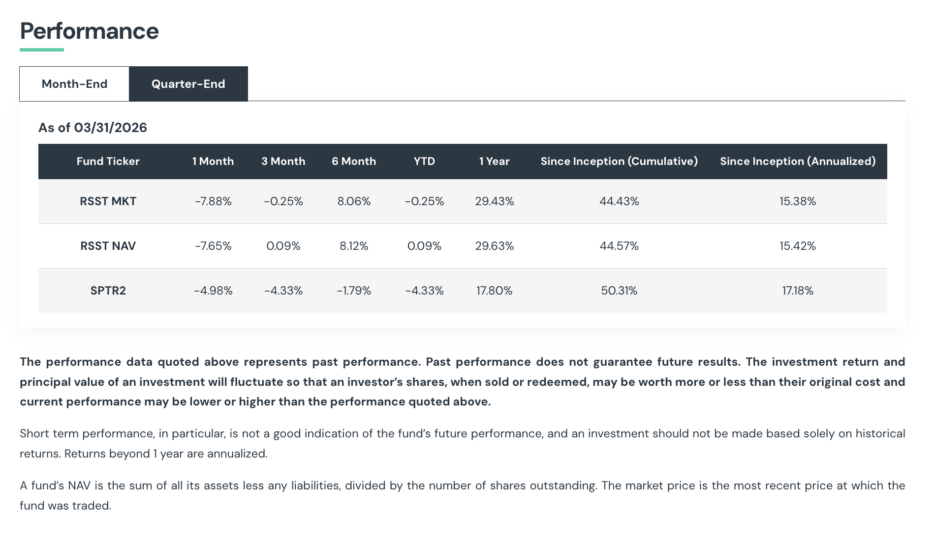
STANDARDIZED PERFORMANCE
Return Stacked® U.S. Stocks & Managed Futures ETF
For the most recent month-end performance, please call 1-844-737-3001 or visit the Fund’s website at www.returnstackedetfs.com/rsst.
The Gross Expense Ratio for RSST is 0.99%.
SPTR2 is the S&P 500 Total Return Index.

Slide 21
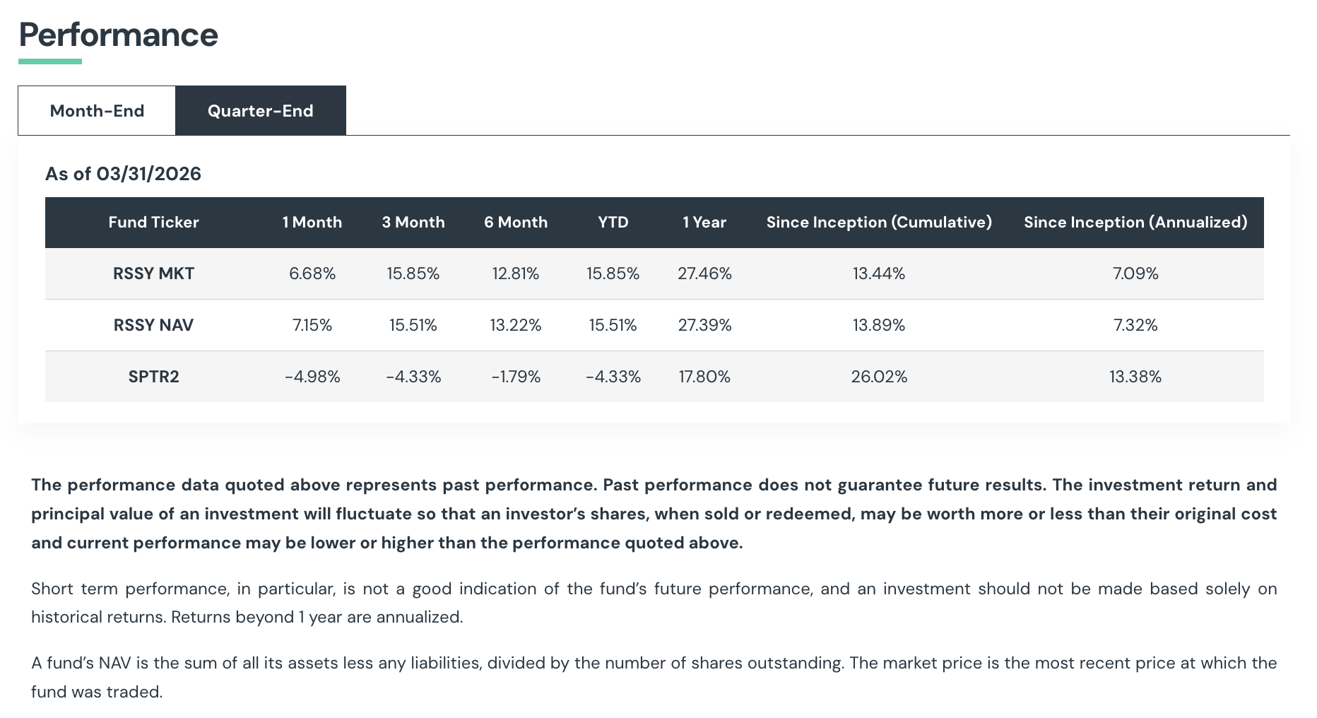
STANDARDIZED PERFORMANCE
Return Stacked® U.S. Stocks & Futures Yield ETF
For the most recent month-end performance, please call 1-844-737-3001 or visit the Fund’s website at www.returnstackedetfs.com/rssy.
The Gross Expense Ratio for RSSY is 0.99%.
SPTR2 is the S&P 500 Total Return Index.

Slide 22

Questions?
Explore the products
Talk to your wholesaler
Read the research
returnstackedetfs.com
Contact your regional rep
Explore our blog
Prospectuses, fact sheets, and complete fund details.
For portfolio modeling, sample allocations, or specific client questions.
Deeper dives into return stacking mechanics and applications.

Slide 23
Learn More
www.returnstackedetfs.com
Contact Us

Slide 24
Definitions
Return Stacked® ETFs
2026
Futures Yield (Carry) is a strategy that invests long and short across commodities, currencies, bonds, and equities via futures using a systematic process driven by measures of asset class yield (sometimes called "carry").
Managed Futures refers to an alternative investment consisting of a portfolio of futures contracts that is actively managed by professionals.
Alternative Stacks refers to funds that tend to allocate to asset classes outside of traditional exposures such as stocks and bonds.
Capital Efficiency refers to the ability for an investment to provide exposure to a particular asset class or strategy while using fewer assets.

Slide 25
Glossary
Return Stacking
2026
S&P 500 Index is an abbreviation for the Standard & Poor’s 500, a market-capitalization-weighted index of 500 leading publicly traded companies in the U.S.
Volatility captures how much a portfolio's returns swing up and down over time by measuring the standard deviation of those returns. A lower volatility indicates steadier, more predictable performance.
Max Drawdown captures the worst loss a portfolio would have experienced by measuring the largest drop from a peak value to a subsequent trough before a new peak is reached. A smaller maximum drawdown indicates the portfolio held up better through its toughest stretch.
Tracking Error quantifies how closely a portfolio’s returns follow those of its benchmark by measuring the standard deviation of the return differences. A lower tracking error indicates tighter alignment with a benchmark.

Slide 26
General Disclosures
Return Stacked® ETFs
2026
The information set forth in this document has been obtained or derived from sources believed by Newfound Research LLC (“Newfound”) to be reliable. However, Newfound does not make any representation or warranty, express or implied, as to the information’s accuracy or completeness, nor does Newfound recommend that the information serve as the basis of any investment decision.
Certain information contained in this document constitutes “forward-looking statements,” which can be identified by the use of forward-looking terminology such as “may,” “will,” “should,” “expect,” “anticipate,” “project,” “estimate,” “intend,” “continue,” or “believe,” or the negatives thereof or other variations or comparable terminology. Due to various risks and uncertainties, actual events or results or the actual performance of an investment managed using any of the investment strategies or styles described in this document may differ materially from those reflected in such forward-looking statements. The information in this document is made available on an “as is,” without representation or warranty basis.
There can be no assurance that any investment strategy or style will achieve any level of performance, and investment results may vary substantially from year to year or even from month to month. An investor could lose all or substantially all of his or her investment. Both the use of a single adviser and the focus on a single investment strategy could result in the lack of diversification and consequently, higher risk. The information herein is not intended to provide, and should not be relied upon for, accounting, legal or tax advice or investment recommendations. Any investment strategy and themes discussed herein may be unsuitable for investors depending on their specific investment objectives and financial situation. You should consult your investment adviser, tax, legal, accounting or other advisors about the matters discussed herein. These materials represent an assessment of the market environment at specific points in time and are intended neither to be a guarantee of future events nor as a primary basis for investment decisions. Past performance is not indicative of future performance and investments in equity securities do present risk of loss.

Slide 27
General Disclosures
Return Stacked® ETFs
2026
Investors should understand that while performance results may show a general rising trend at times, there is no assurance that any such trends will continue. If such trends are broken, then investors may experience real losses. The information included in this presentation reflects the different assumptions, views and analytical methods of Newfound as of the date of this document. The views expressed reflect the current views as of the date hereof and neither the author nor Newfound undertakes to advice you of any changes in the views expressed herein.
This presentation has been provided solely for informational purposes and does not constitute a current or past recommendation or an offer or solicitation of an offer, or any advice or recommendation, to purchase any securities or other financial instruments, and may not be construed as such. This presentation should not be considered as investment advice or a recommendation of any particular security, strategy or investment product.
No part of this document may be reproduced in any form, or referred to in any other publication, without express written permission from Newfound Research.
© Return Stacked® ETFs, 2026. All rights reserved.
Case #91732634-1661-4cd3-abca-026b176f2959

